Slide 1
Project 2 – Filter Design

Slide 2
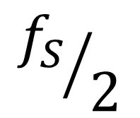
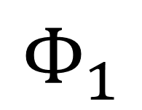
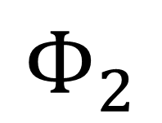
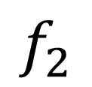
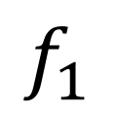
| H(Ω) |
$$f_{1}$$
$$f_{2}$$
$${f_{S}}/2$$
$$Φ_{1}$$
$$Φ_{2}$$
π

Slide 3


Imaginary
Z-plane
1
Z3
P3
P1
Z1
$$Φ_{2}$$
$$Φ_{1}$$
1
Real
P2
Z2
P4
Z4

Slide 4
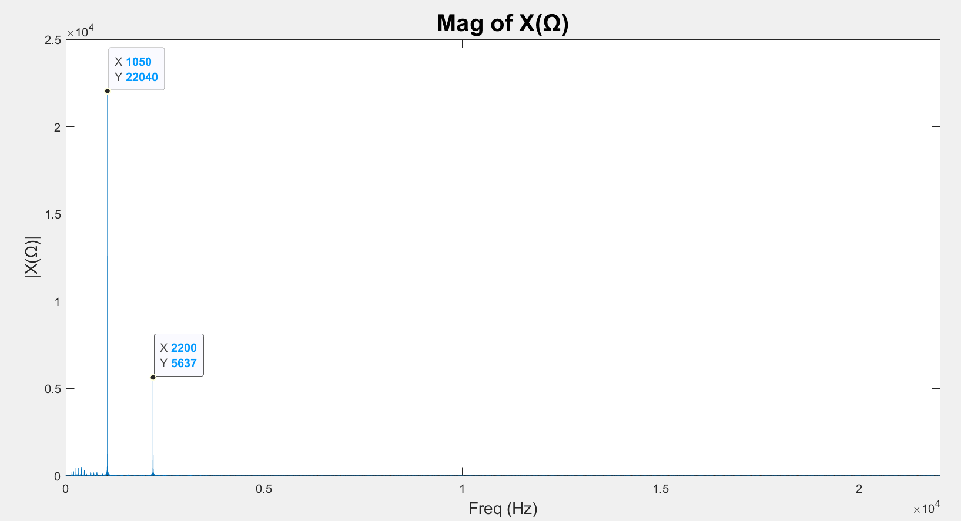
f
/2
S

Slide 5
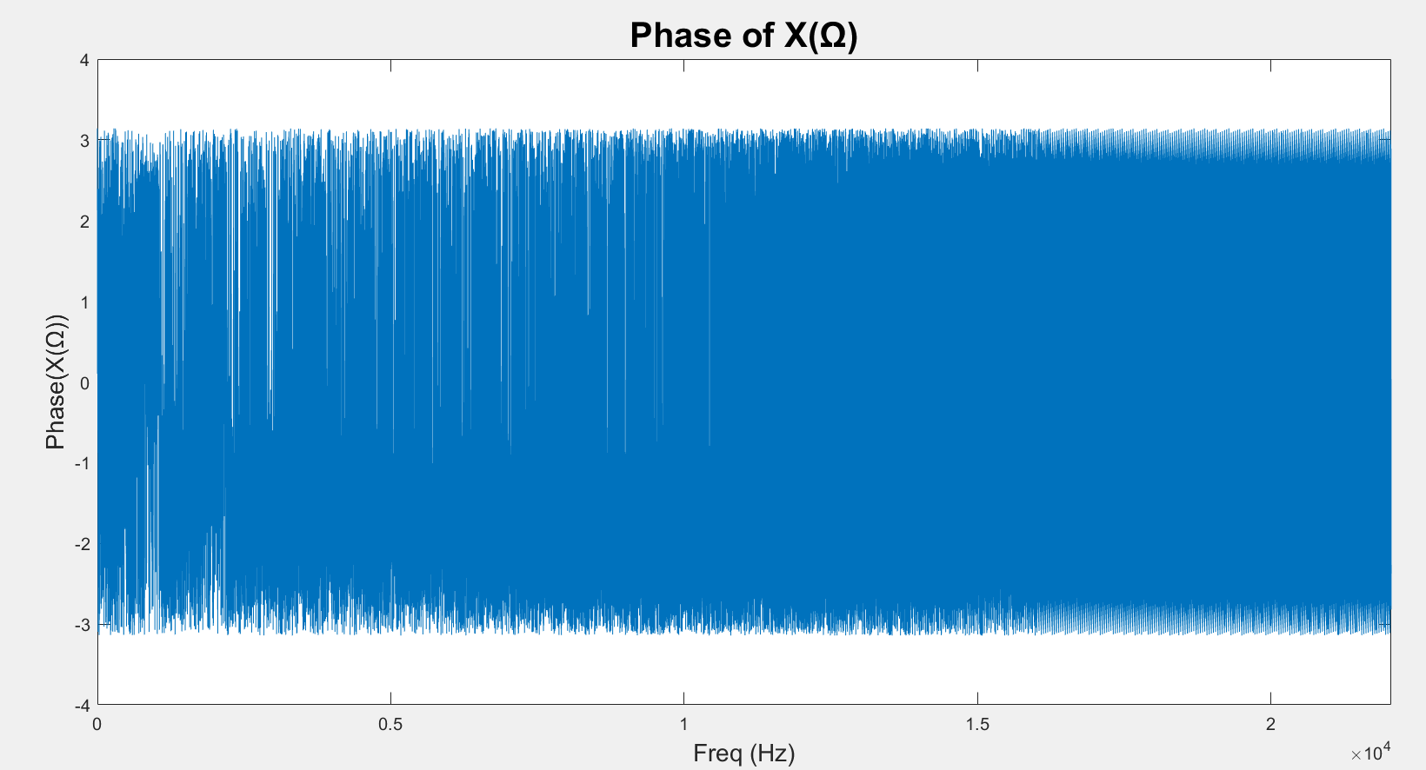
f
/2
S

Slide 6
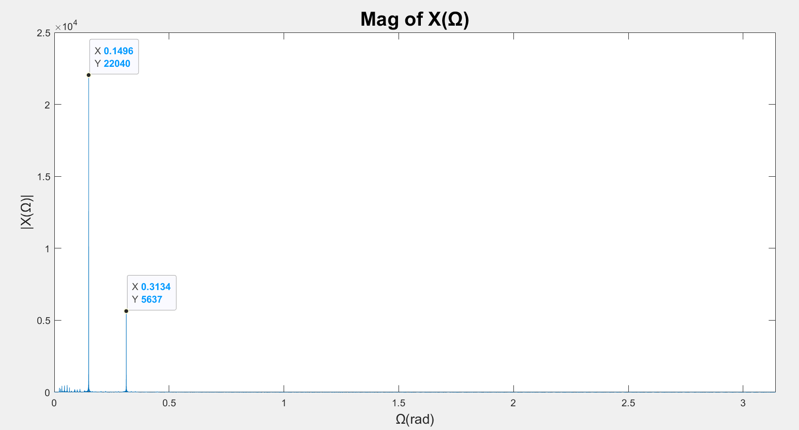
π

Slide 7
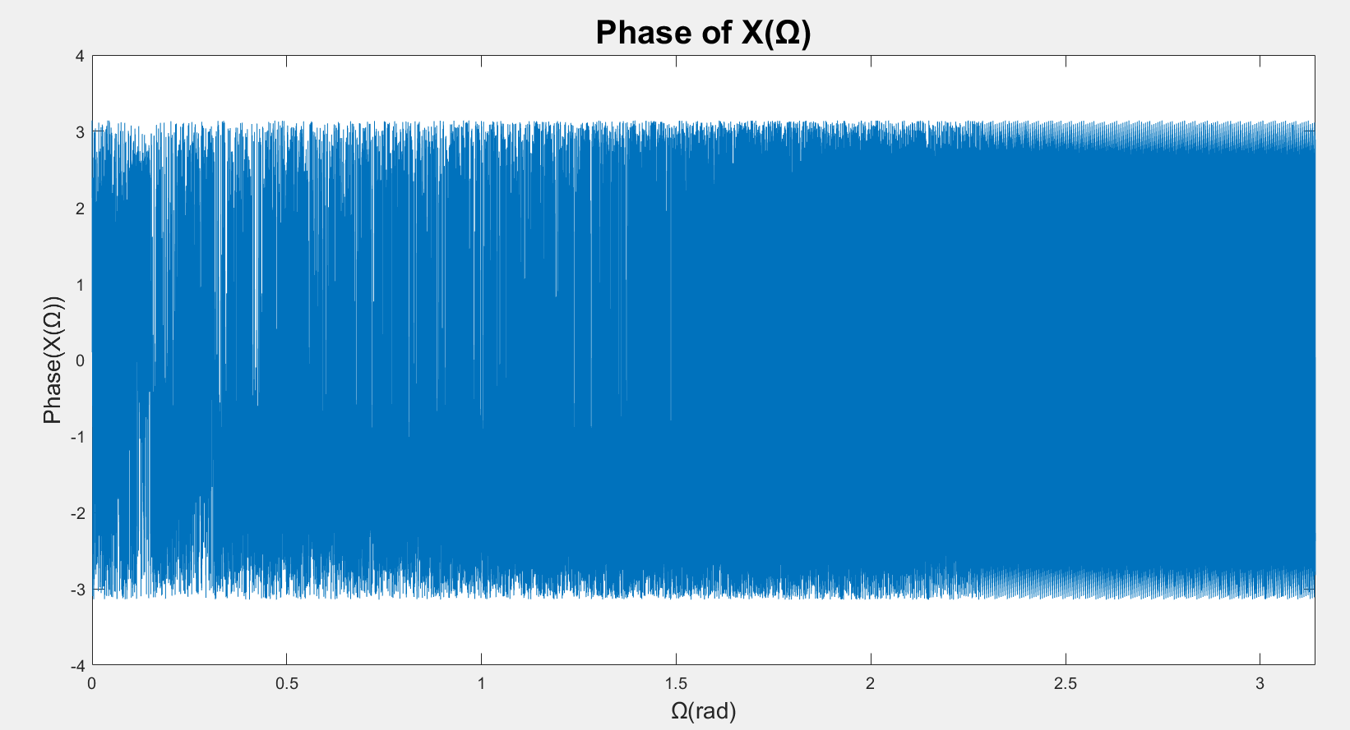
π

Slide 9
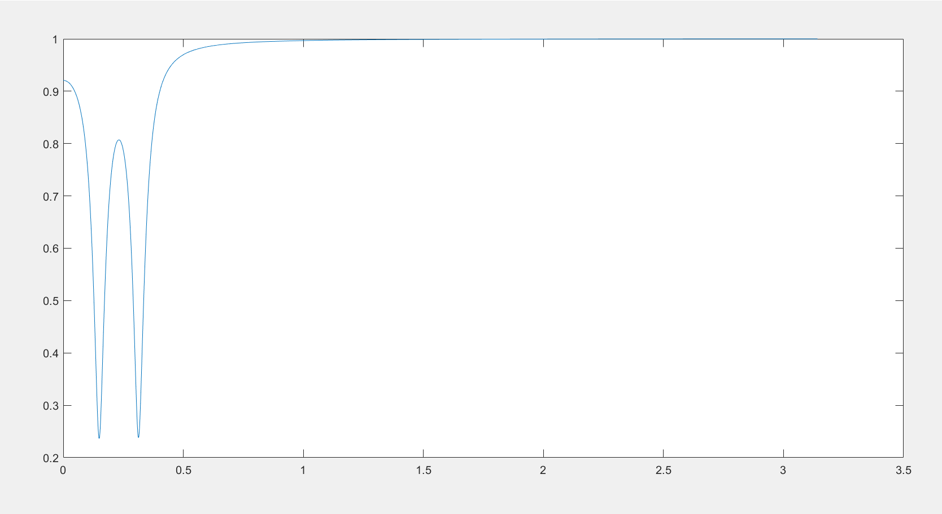
Magnitude of H(Ω)
|H(Ω)|
0.15
0.313
Ω (rad)

Slide 10
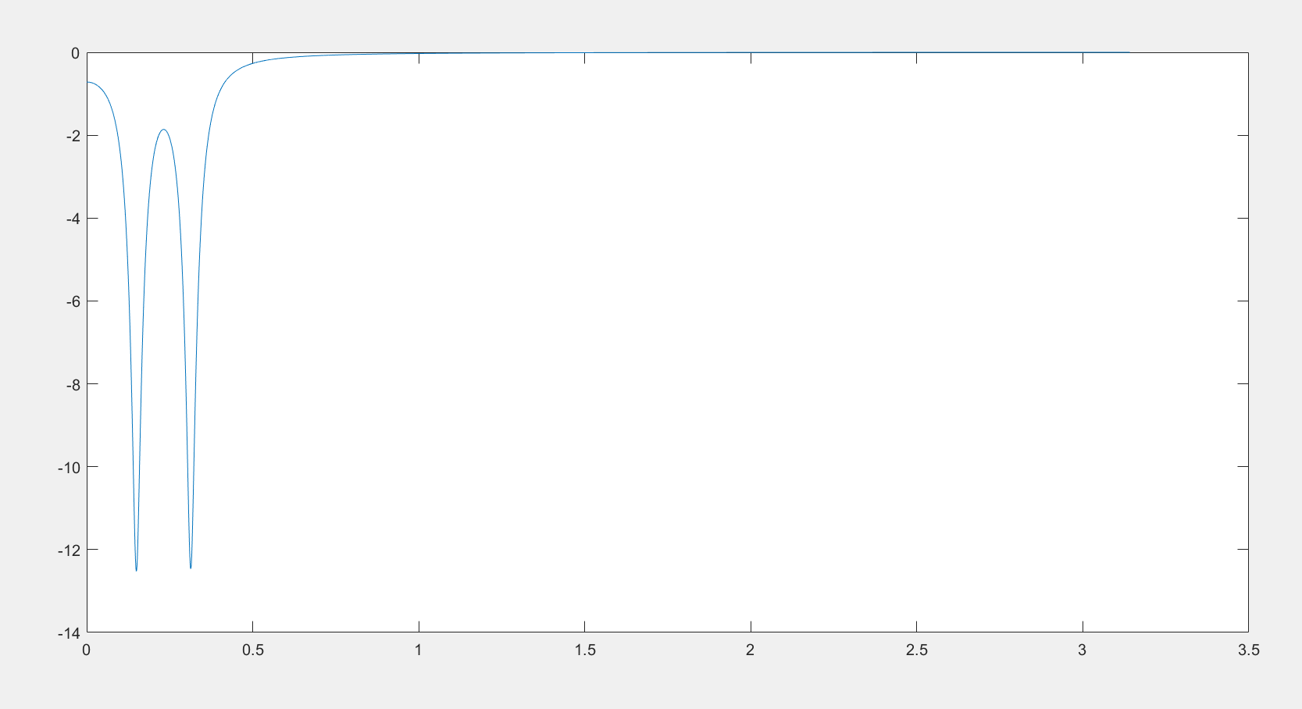
Magnitude of H(Ω) in dBs
|H(Ω)| (dB)
0.15
0.313
Ω (rad)

Slide 11
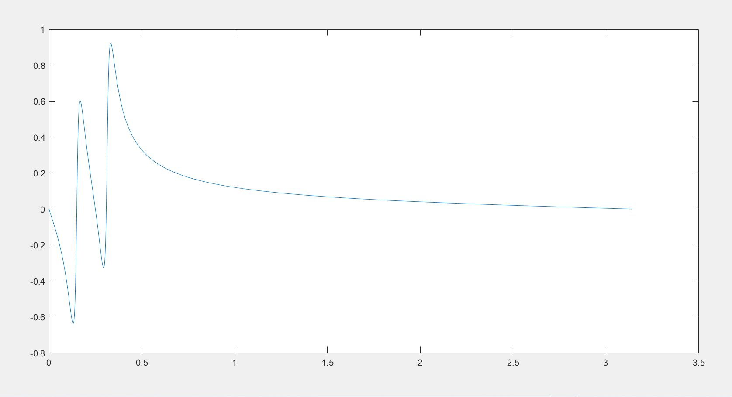
Phase of H(Ω)
Phase(H(Ω))
Ω (rad)

Slide 12
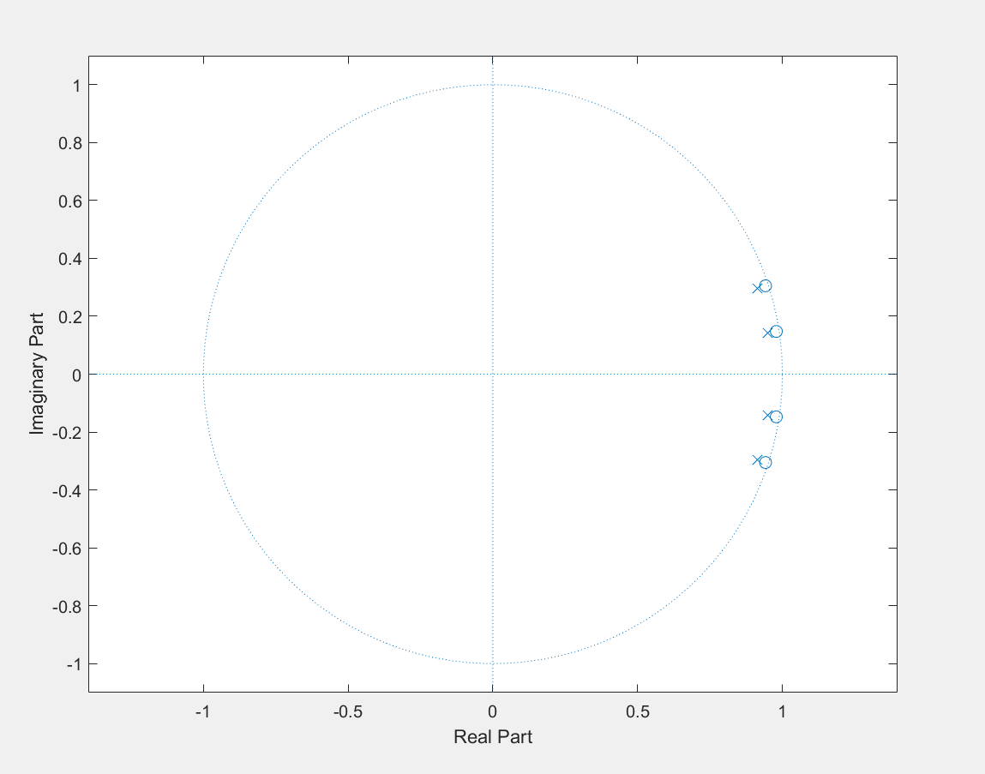
Z-Plane

Slide 13
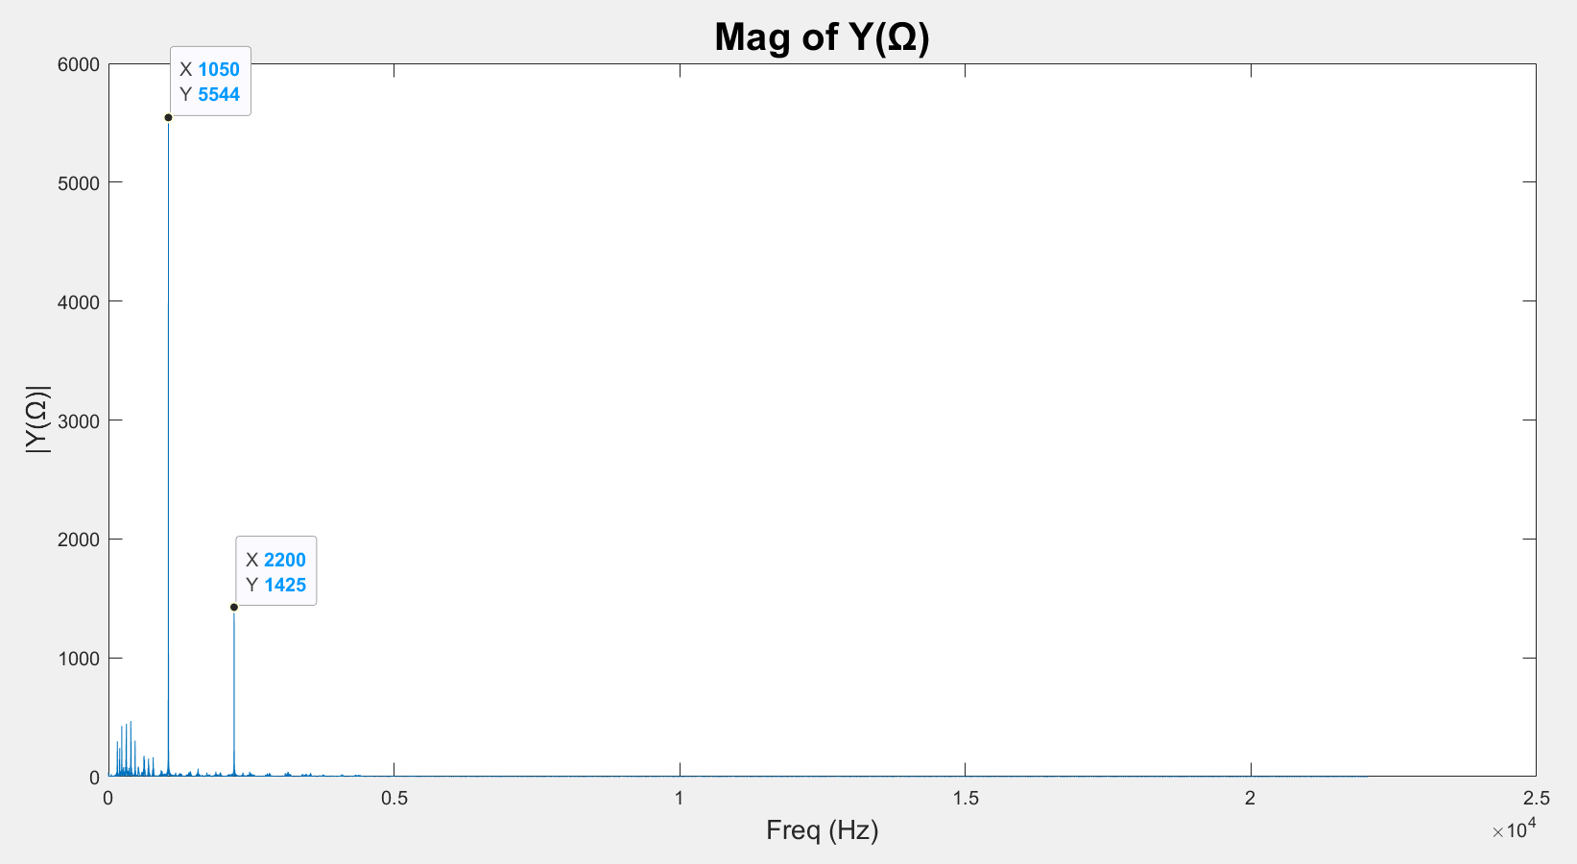
Magnitude of the disturbing tones is still very high with the 1st order design, where there is only 1 pole or 1 zero per location in the z-plane.

Slide 14
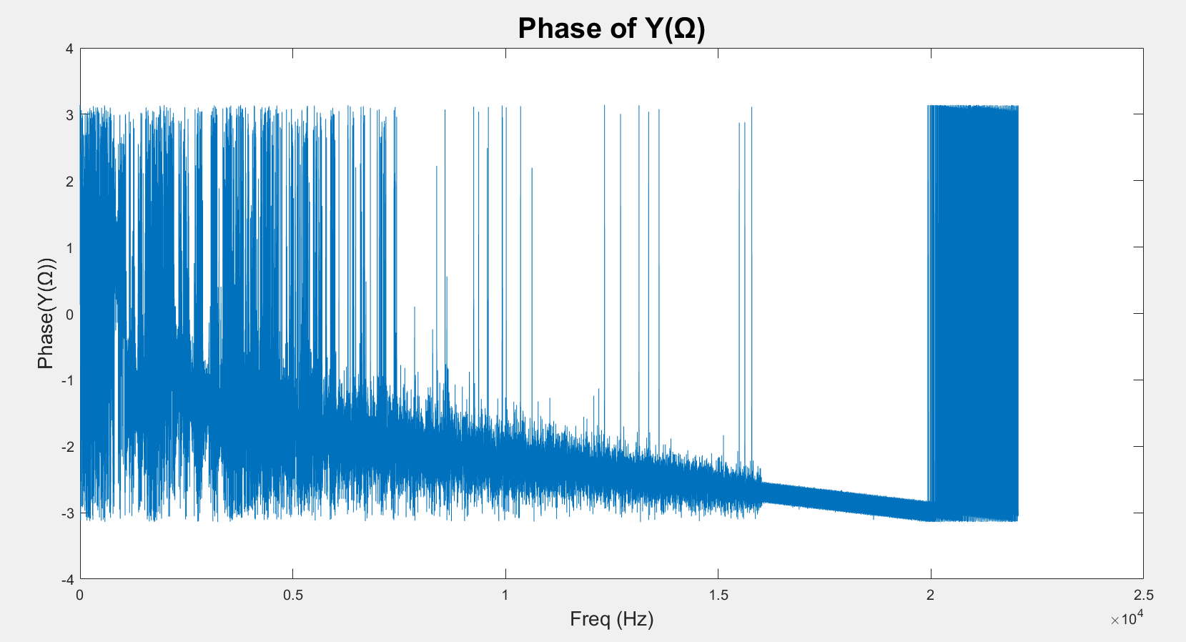

Slide 16
X(z)
Y(z)
H(z)
H(z)
H(z)
H(z)
H(z)
H (z) = H(z). H(z). H(z). H(z). H(z)
new

Slide 17
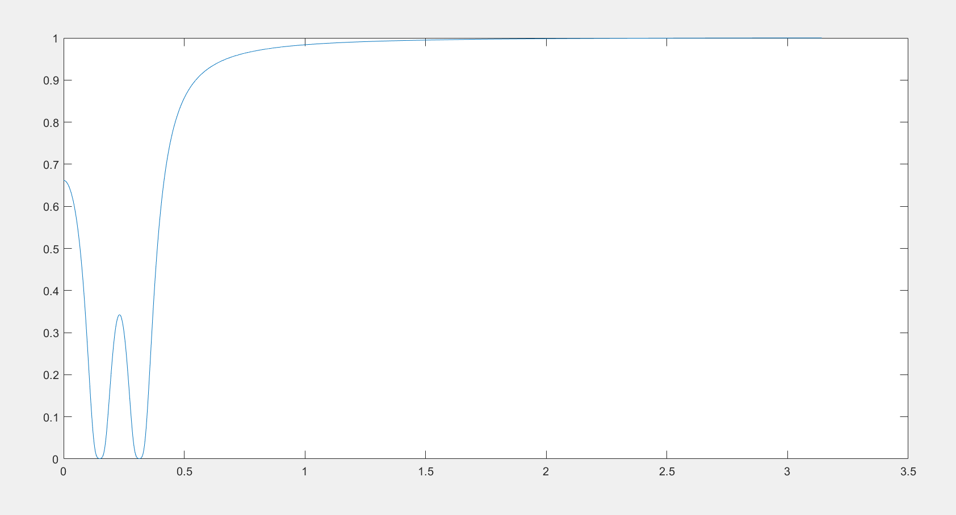
Magnitude of H(Ω)
|H(Ω)|
0.15
0.313
Ω (rad)

Slide 18
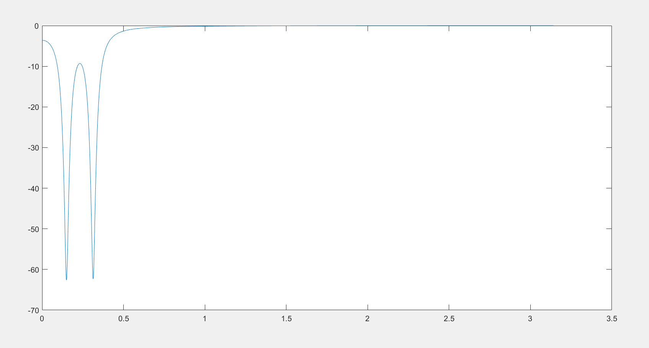
Magnitude of H(Ω) in dBs
|H(Ω)| (dB)
0.15
0.313
Ω (rad)

Slide 19
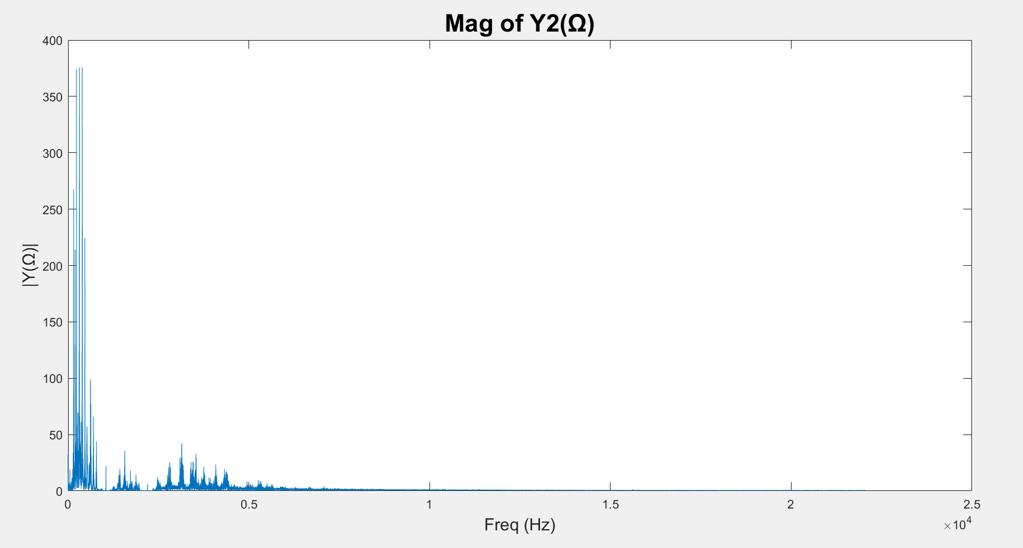

Slide 20
